Slide 1
FY24-25 Supplemental Request, Recent Outcomes, and Agricultural Water Quality
Paul Gardner, Administrator
651-757-2384 Paul.Gardner@state.mn.us
House Legacy Finance Committee February 21, 2024

Slide 2
SE Minnesota Public Health Response
$6.354M for public health response (MDH) to EPA petition on nitrate in private wells
Builds on pilot county public health program & existing FY24-25 appropriation
Identify wells, test, educate, Report results
Alternative water with mitigation (new wells, RO systems)—constitutional discussion
CWC doesn’t want CWF as long-term approach for mitigation

Slide 3
Additional Southeast MN Nitrate Response
$1M to Nitrate in Groundwater program (MDA)
Technical assistance to farmers
$1.402M to Agricultural Best Management Practices Loan Program (MDA)
Low interest loans for equipment or safe drinking water
$2M Working Land & Floodplain Easements (BWSR)
Potential federal match

Slide 4
PFAS Response
$326,000 River and Lake Monitoring for PFAS (MPCA)
Adds PFAS to program
$90,000 Fish Contamination Assessment (DNR)
Adds PFAS to program
$384,000 Drinking Water Contaminants of Emerging Concern (MDH)
Health-based guidance for fish consumption

Slide 5
Other Supplemental Requests
$2M Critical Shoreland Easements (BWSR)
Backlog of requests for priority parcels in Rum River watershed
$1M Low-income SSTS grants (MPCA)
Supports 70 additional septic system replacements
$2M Watershed Partners Legacy Grants (BWSR)
Supports tribes & NGO projects
$1M Great Lakes Restoration Initiative Lakewide Action & Management Program (MPCA)
NE MN SWCD capacity, apply for match

Slide 6
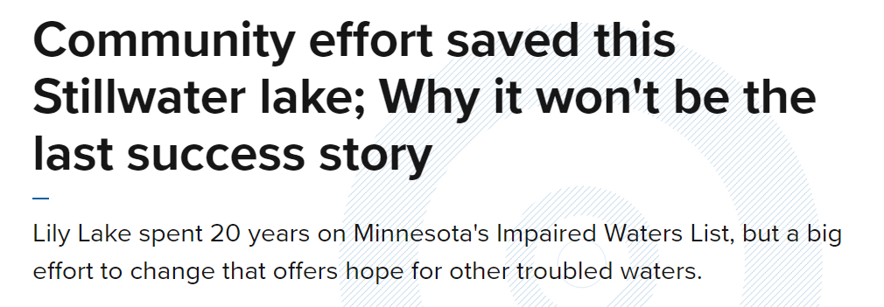
Draft Impaired Waters List
Required by U.S. EPA
Minnesota looks for more contaminants in more places with often more protective standards so our list is BIGGER
10-20 year lag between detection and de-listing
Metro waters had a head start

Slide 7
Good News: Phosphorus Loads Declining

Slide 8
Good News: Lake Clarity Mostly Increasing

Slide 9
Bad News: Metro Chloride Increasing

Slide 10
Good News/Bad News: Phosphorus Down, Nitrate Up

Slide 11
Agriculture and Water Quality: CWF Role
Enhanced compliance and enforcement
Buffer law, SSTS, Groundwater Protection Rule
Taking some land out of production with easements—23,830 acres
Technical assistance
Low interest loans for equipment
Structural practices
Promoting more vegetated cover
Trends generally improve where we spend money

Slide 12
Pursuasion Brings Results…Slow but Steady
"With the cover crops and reduced tillage alone, we have seen better yields during droughts and have reduced our waiting time to resume planting and harvesting after a heavy rain event due to the increased soil aggregation and water infiltration within our fields. Plus, we have also cut out a third of our fuel use.”
-Glenn Hjelle, Grant County farmer
1,450 farms and 1,000,000+ acres enrolled in Minnesota Agricultural Water Quality Certification Program

Slide 13
Groundwater Protection Rule
Identify public water supplies with elevated nitrogen
Target technical/financial assistance with CWF
Modeling provides options for landowners
Regulation kicks in if voluntary approach isn’t working

Slide 14
Challenges
Rented acres
Just under half of acreage
Commodity markets
Conservation lands dropped by >1 million acres between 2017 and 2022 (Federal CRP changes?)

